Slide 1

Introducing caring@home resources
Presented by:
[Insert your name here]
[Insert your organisation here]
caring@home is funded by the Australian Government and led by the Brisbane South Palliative Care Collaborative
Notes:
Notes: ​
It is recommended that before you run this session with your team that you have: ​
Completed the online modules on the caring@home website​
Watched the short training videos​
Obtained and familiarised yourself with all the resources and how to access them​
Ensured that you have internet availability to demonstrate how to access the online modules for registered nurses.​
The resources include: ​
The caring@home package for carers (the package can be either ordered or most components downloaded from the caring@home website)
The Palliative Care Clinic Box ​(the package can be either ordered or most components downloaded from the caring@home website)
‘Guidelines for the handling of palliative care medicines in community services’​
The ‘Example policy and procedures: Supporting carers to help manage breakthrough symptoms safely using subcutaneous medicines in the home’​
The ‘Prompts for End-of-Life Planning (PELP) Framework
The ‘National Core Community Palliative Care Medicines List’ ​
The palliMEDS app downloaded onto your phone

Slide 2
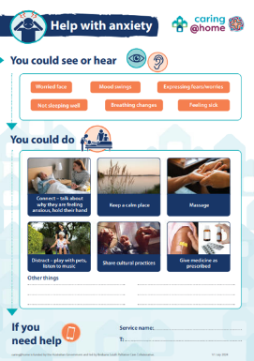
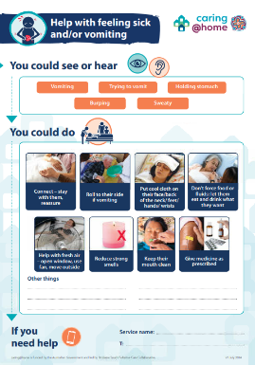
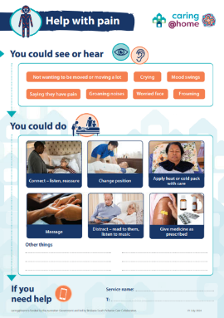
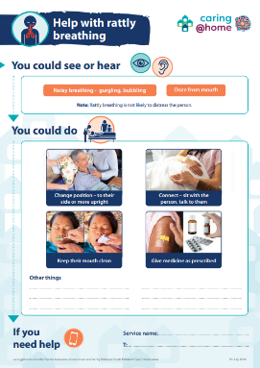
Tip sheets
Notes:
Facilitator notes: The tip sheets provide written and pictorial information about how to identify a symptom and what actions can be taken to help the person being cared for. ​

Slide 3
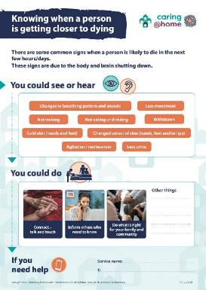
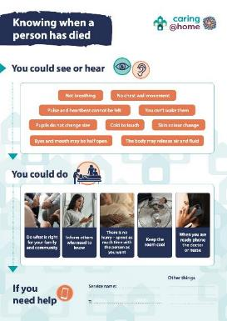
Recognising dying
Notes:
Facilitator notes: The tip sheet provides written and pictorial information about how to identify when a person is nearing death and how to identify when a person has died.

Slide 4
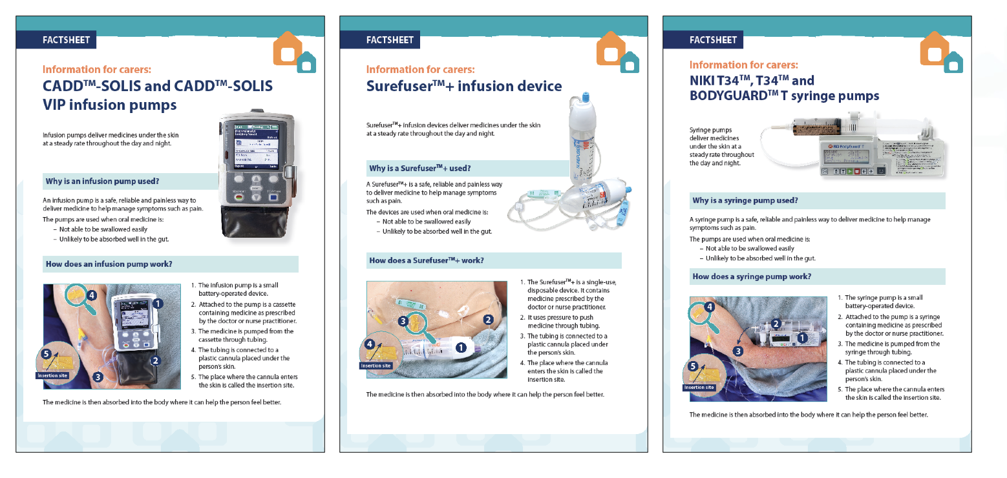
Understanding infusion devices
Notes:
Facilitator notes: The factsheets provide written and pictorial information about how infusion pumps and devices work and how to help manage them in the home.

Slide 5
Providing practical care
Notes:
Facilitator notes: The illustrated guides and videos explain how to provide practical care for someone in the home using a step-by-step approach.

Slide 6
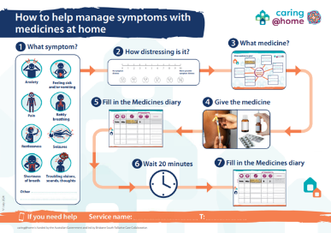
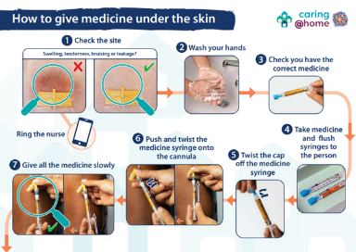
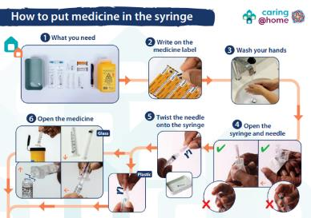
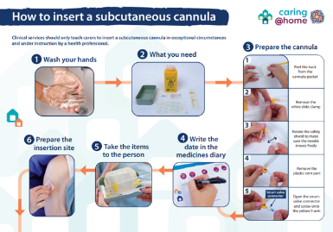
Step-by-step guides for managing subcutaneous medicines
Notes:
Facilitator notes:
The handbook provides written information and pictures that the carer may need to help manage breakthrough symptoms safely using subcutaneous medicines.
The medicines diary is used to record all the subcutaneous medicines that the carer gives to the person they are caring for.
The two illustrated guides explain to the carer, using a step-by-step approach, how to:
Write a label, open an ampoule and draw up medicine
Give medicine using a subcutaneous cannula.

Slide 7
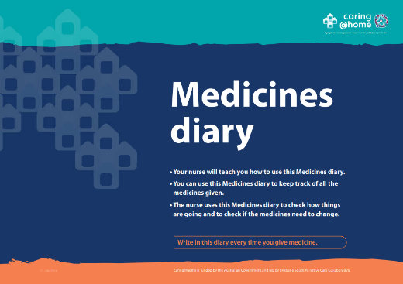
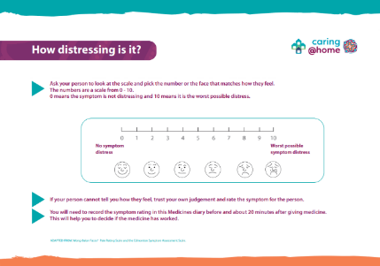
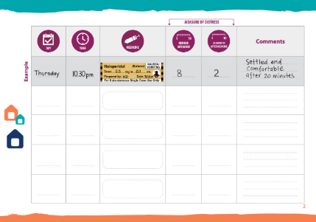
Medicines diary
Notes:
Facilitator notes:
The medicines diary is used to record all the subcutaneous medicines that the carer gives to the person they are caring for.

Slide 8

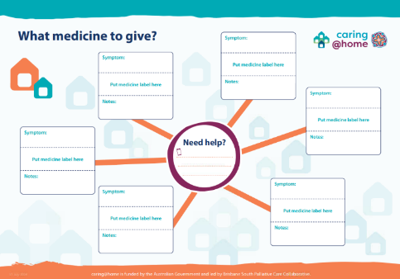






Colour-coded labelling system
Syringe labels
Wall chart
Notes:
Facilitator notes:
The colour-coded labelling system acts as an extra safety check for the carer to help them select the correct medicine for each breakthrough symptom. It includes:
Colour-coded sticky labels for syringes and
Symptoms and medicines: Colour-coded wall chart
The colour-coded labelling system is adapted from: Australian Commission on Safety and Quality in Health Care. National Standards for User-applied Labelling of Injectable Medicines, Fluids and Lines. 2015.
The nurse must always reiterate to the carer that the most important thing is to check the label on the syringe. This is an important part of the competency check.

Slide 9
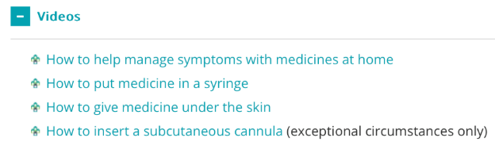
Carer training videos
caringathomeproject.com.au
Notes:
Facilitator notes:
The videos show how to do each step when giving subcutaneous medicine.
The videos support carers’ different learning styles.

Slide 10
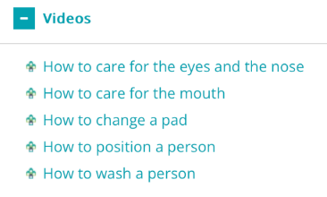
Practical care carer training videos
caringathomeproject.com.au
Notes:
Facilitator notes:
The videos show how to do each step when providing practical care.
The videos support carers’ different learning styles.

Slide 11
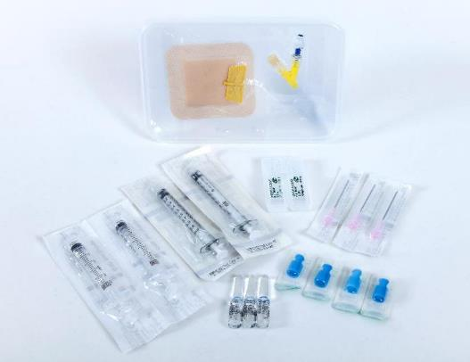

Practice demonstration kit
Notes:
Facilitator notes: The practice demonstration kit can be used by nurses as a teaching aid during the one-on-one training session and by carers to practice giving medicines through a subcutaneous cannula during and after the training session. ​
​The practice demonstration kit consists of a disposal plastic box with a subcutaneous cannula inserted into a stoma-type adhesive dressing on the lid of the box. The dressing mimics a person’s skin. The other equipment in the plastic box includes blunt drawing-up needles, glass and plastic ampoules, syringes (1mL and 3mL) and syringe caps.​

Slide 12
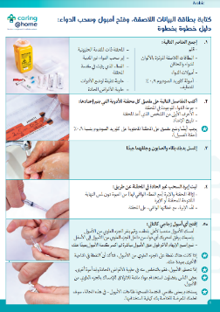
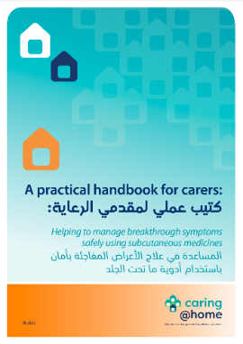
Translated resources
The key resources of carers/families are available in 9 commonly spoken languages in Australia: Arabic, Greek, Hindi, Italian, Punjabi, Simplified Chinese, Traditional Chinese, Tagalog, Vietnamese.
The resources that have been translated are:
A4 introductory brochure
Practical handbook for carers
Writing a label, opening an ampoule and drawing up medicine: A step-by-step guide​
Giving medicine using a subcutaneous cannula: A step-by-step guide​
Medicines diary
Fridge chart
Short training videos

Slide 13
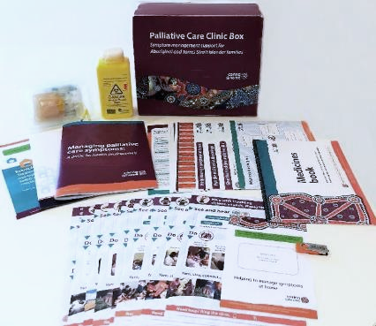
Resources for Aboriginal families
Introductory brochure
Tip sheets
Step-by-step guides
Medicines book
Wall chart
Syringe labels
A practice demonstration kit
Short training videos (available in English and 8 First Nations languages)

Slide 14
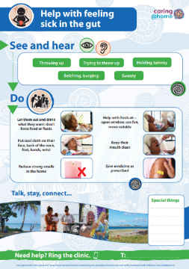
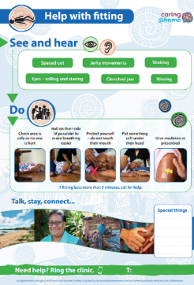
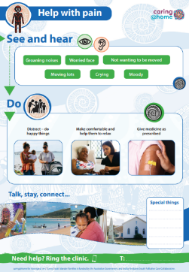
Resources for Torres Strait Islander Families
Several of these resources have been produced with Torres Strait Islander-specific artwork including:
Introductory brochure
Tip sheets
Step-by-step guides
Medicines book
Wall art

Slide 15
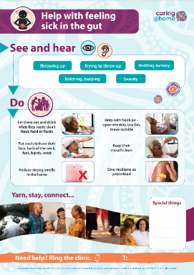
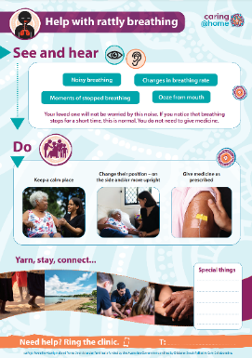
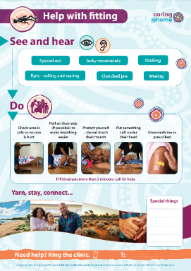
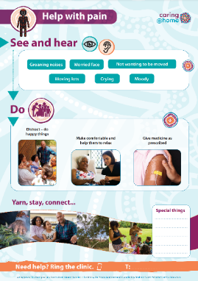
Tip sheets
Notes:
Facilitator notes:
The tip sheets provide written and pictorial information about how to identify a symptom and what actions can be taken to help the person being cared for.

Slide 16
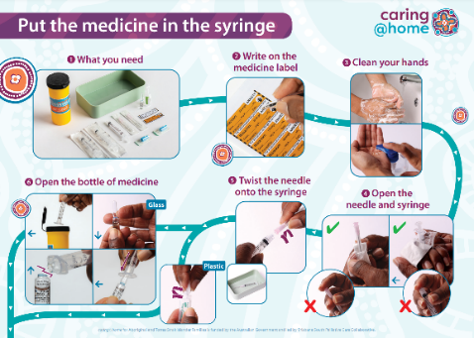
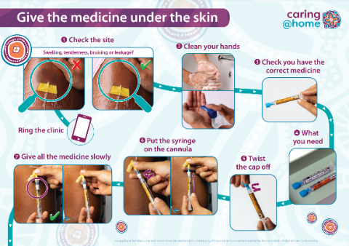
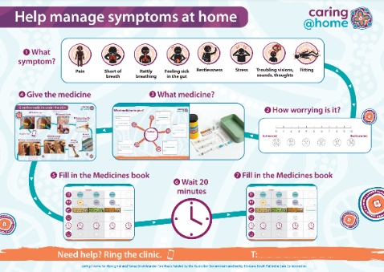
Step-by-step guides
Notes:
Facilitator notes:
Help manage symptoms at home: This illustrated guide explains how to manage symptoms at home by giving medicine.
Put the medicine in the syringe: This illustrated guide explains how to label a syringe correctly, open an ampoule and draw up medicine using a step-by-step approach.
Give the medicine under the skin: This illustrated guide explains how to give medicine through a subcutaneous cannula using a step-by-step approach.

Slide 17
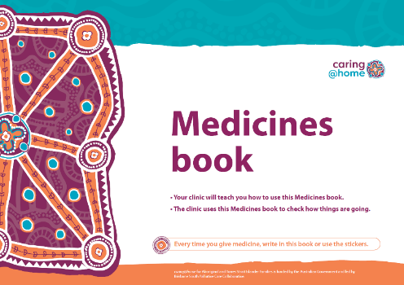
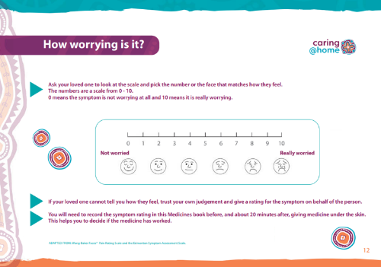
Medicines book
Notes:
Facilitator notes:
The medicines book is for families to record all the subcutaneous medicines that are given.

Slide 18
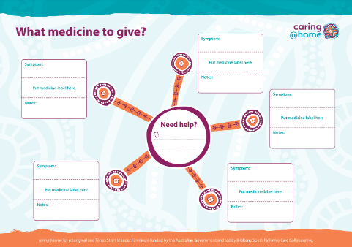
Colour-coded labelling system
Syringe labels
Wall chart
Notes:
Facilitator notes:
The colour-coded labelling system acts as an extra safety check for the carer/family to help them select the correct medicine for each breakthrough symptom. It includes:
Colour-coded sticky labels for syringes and
A wall chart
The colour-coded labelling system is adapted from: Australian Commission on Safety and Quality in Health Care. National Standards for User-applied Labelling of Injectable Medicines, Fluids and Lines. 2015.
The nurse must always reiterate to the carer/family that the most important thing is to check the label on the syringe. This is an important part of the competency check.

Slide 19
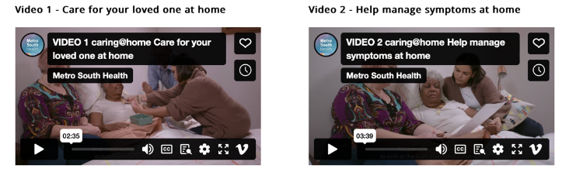
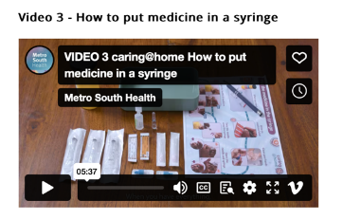
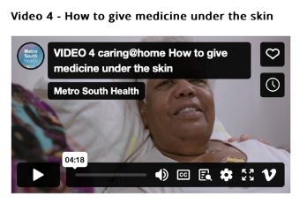
Short training videos for carers
caringathomeproject.com.au
Notes:
Facilitator notes:
The videos show how to do each step when giving subcutaneous medicine.
The videos support carers’ different learning styles.

Slide 20
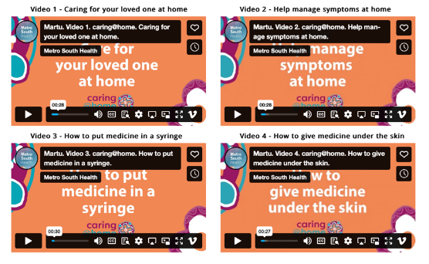
Short training videos for carers with voiceover
Creole (Torres Strait)
Eastside Kriol (NT)
Kriol (WA)
Martu (WA)
Ngaanyatjarra (NT)
Pitjanjatjara (NT)
Warlpiri (NT)
Yolngu Matha (NT)
caringathomeproject.com.au
Notes:
Facilitator notes:
The videos show how to do each step when giving subcutaneous medicine.
The videos support carers’ different learning styles.

Slide 21
Feedback
“I am just emailing you to say that I received my carers' package from caring@home last week. Our healthcare staff have expressed how comprehensive and useful these packs appear to be.
Yesterday my colleague used a package with a family who took their mum home for a home death and the feedback from the family was great. They were able to go through the information and practise overnight with the equipment supplied, whilst their mum remained in hospital.
My colleague returned to the ward this morning and the family were able to demonstrate how to do everything on the (competency) checklist you provided. In summary, this is an amazing resource for patients, carers and nurses."
Palliative Care CNC, NSW

Slide 22
References
Swerissen H, Duckett S. Dying well. Grattan Institute. 2014. Available from: https://grattan.edu.au/wp-content/uploads/2014/09/815-dying-well.pdf [Accessed 3 December 2018].​
Productivity Commission. Introducing Competition and Informed User Choice to Human Services: Reforms to Human Services, Report No. 85, Canberra; 2017. Available from: https://www.pc.gov.au/inquiries/completed/human-services/reforms/report/human-services-reforms.pdf [Accessed 6 December 2018].​
Rosenberg JP, Bullen T, Maher K. Supporting family caregivers with palliative symptom management: A qualitative analysis of the provision of an emergency medication kit in the home setting. Am J Hosp Palliat Care. 2015; 32(5): 484-489. Available from: https://doi.org/10.1177%2F1049909114531326. [Accessed 6 December 2018].​
Shepperd S, Gonçalves-Bradley DC, Straus S, Wee B. Hospital at Home: home-based end-of-life care. Cochrane Database Syst. Rev. 2016; 2: 1465-1858. Available from: https://doi.org/10.1002/14651858.CD009231.pub2. [Accessed 6 December 2018].​

Slide 23
References
Latter S, Hopkinson JB, Lowson E, et al. Supporting carers to manage pain medication in cancer patients at the end of life: A feasibility trial. Palliat Med. 2018; 32(1): 246-256. Available from: https://doi.org/10.1177/0269216317715197. [Accessed 6 December 2018].​
Payne S, Turner M, Seamark D, et al. Managing end of life medications at home – accounts of bereaved family carers: a qualitative interview study. BMJ Support Palliat Care. 2015; 5: 181-188. Available from: http://dx.doi.org/10.1136/bmjspcare-2014-000658. [Accessed 6 December 2018].​
Healy S, Israel F, Charles M, Reymond L. Laycarers can confidently prepare and administer subcutaneous injections for palliative care patients at home: A randomized controlled trial. Palliat Med. 2018; 32(7): 1208-1215. Available from: https://doi.org/10.1177%2F0269216318773878. [Accessed 6 December 2018].​
Israel F, Reymond L, Slade G, Menadue S, Charles MA. Lay caregivers’ perspectives on injecting subcutaneous medications at home. Int J Palliat Nurs. 2008; 14(8): 390-395. Available from: https://doi.org/10.12968/ijpn.2008.14.8.30774. [Accessed 6 December 2018].​

Slide 24
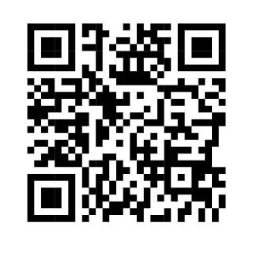





Contact us
1300 600 007
caringathomeproject.com.au
caringathome@health.qld.gov.au

